Slide 1
TestCenter AI
Vasu Sankaran

Slide 2
TestCenter AI - Project Goals
System testing of network devices, providing intelligent test, analysis and guidance to a User.
System tests involving actual SUTs, i.e. not for STC back to back testing like Smarttest.
Reduce human capital and time expended in testing.
Given an objective for testing activity, determine which test case(s) need to be run.
Intelligent analysis of results after ingesting events / logs from the Spirent endpoints involved in the test, from the DUT/SUT and data from external sources.

Slide 3
TestCenter AI - Architecture
Comprised of 2 core components.
Test Scripts Library
Develop a library of tests, based on customer requirements and scenarios compiled by various R&D teams. These will be system tests involving actual SUTs, i.e. not for STC back to back testing like Smarttest.
Existing test-methodologies within methodology center will be reviewed.
TestCenter AI
Comprised of a test case metadata library describing the test scripts above. Well indexed, meta-data rich and can be searched based on various objectives of the testing activity.
An intelligent test results analyzer that understands STC and SUT events and config, and data from other sources.
Incorporate machine learning techniques and autonomous testing over time.

Slide 4

Example Test Automation Platform
TestCenterAI
Test case Library
CI Test Job (Jenkins)
TestCenter AI Service
Test scripts Library
Test result diagnosis rules
Test Executive
Events DB
Magellan
Results
Other Data Sources
Test Agent
Chassis
DUT
Test Agent
Chassis
DUT
Test results
Test Agent
Chassis
DUT
Phase 1
Phase 2
Spirent + Other Data Sources

Slide 5
Component Functions
TestCenterAI
Test case Library
Responsible for intelligent test and analysis functions
Will be implemented as a service, with data stores for test case library and test result diagnosis rules.
TestCenter AI Service
Test result diagnosis rules
Test scripts Library
Repository containing the actual test scripts
Events DB
Persistent store of events from STC or ingested from SUT, as described in Event Framework architecture
Magellan
Results
Results service for accessing detailed test results
Other Data Sources
External data sources, such as those with NFV testing

Slide 6
Component Functions
These remaining components are illustrative of a Test Executive such as our internal Smarttest system. They may be different in a customer environment.
CI Test Job (Jenkins)
Job triggered by build events. Will query TestCenter AI for test cases to execute based on CI tags, etc.
Test executive master, to execute selected test cases on available slave agents based on test hardware requirements, available port pairs, etc.
Test Executive
DB to store pass / fail test results along with other information required for analysis, such as testbed config
Test Agent
Chassis
DUT
Test results
Test Agent
Chassis
DUT
Test Agent
Chassis
DUT

Slide 7
Component Description - TestCenter AI
Responsible for intelligent test and analysis functions. It will be implemented as a service, with data stores for test case library and test result diagnosis rules.
I. REST API for Test Case Library CRUD
The TC Library contains metadata about test cases (the test scripts themselves are expected to reside in a repository external to TestCenter AI). This REST API is for managing test cases. Tags, test categories, etc. can also be managed via this API
What metadata?
Test case priority Test Category - Acceptance or Unit or Performance MarketSegment = CDC | Verified Defects Test case owner Protocol = BGP_BLL | System Under Test Test Duration

Slide 8
Component Description - TestCenter AI
Customers who have their own automation scripts can integrate with TestCenter AI for intelligent analysis capabilities by creating Test Case Library records providing metadata about their automation scripts
Customers can customize existing tests and modify testbed config
II. REST API to Query Test Cases
Generates test case(s) to be run based on various query criteria, such as the following:
Test pack or test suite id Script tags derived from CI build jobs. Test cases to verify specific defects Test cases owned by specific Team All Priority 1 tests Acceptance tests tagged with “BGP” | Performance tests applicable to specific hardware module Test cases targeting a Market Segment “Snapshot” style testing - select test cases that are quick to execute. Tests with recent history of failure.

Slide 9
Component Description - TestCenter AI
III. Diagnostic engine for analyzing test results.
Intelligent analysis that incorporates all relevant data - STC and DUT events, Magellan Results, other external data sources.
Start with a simple dependency matrix with contextual information about the test – if TC A fails, run TC B, etc.
Enhance analysis capabilities to take into account STC and DUT events, DUT config, Magellan results, and other data sources.
Apply machine learning techniques and data analytics. This is a list that will grow over time. Some example applications -
Early detection of cascading failures based on test case relations
Detect trends based on time series across multiple tests
Learn relationships amongst test cases based on metadata
Build initial set of rules manually as we develop tests and gather experience analyzing failures. This will enable us to define an API for generating and working with analysis rules, and then customer training involved

Slide 10
Component Description - TestCenter AI
** TestCenter AI not for analysis of live results **
Use case - detecting and short-circuiting failed tests, for example, if there is frame loss early in a long test user might value an automated abort rather than waiting the entire duration for the test to fail.
Should be in the base product. Customer shouldn’t have to buy an add-on product (TC AI) to get this.. we should consider it as an enhancement for base STC.

Slide 11
Component Description - Test Scripts Library
Repository of automation test scripts
developed by SysTest team at Spirent, or
customer’s automation library
Requirements
Test Scripts library decoupled from TestCenter AI - intent is to enable customers who already have their own automation library to populate TestCenter AI with test case metadata about their test scripts, and avail of intelligent analysis capabilities.
Sets of Spirent system test scripts could potentially be packaged and sold as “Test Packs”.
For our scripts, the source of test case metadata will be in yaml files accompanying the test scripts themselves, so that there is a single source of truth. These yaml files will be parsed to populate test cases using TestCenter AI’s REST API. The json specification for TC metadata will be available in our source repository.

Slide 12
Component Description – Test Scripts Template
Anatomy of a test script
For tests to be reusable across devices and vendors
Spirent¹ commands …
Connect to DUT
Configure DUT
Spirent commands …
DUT commands …
Spirent commands …
Collect DUT logs / events
Spirent commands …
DUT commands
must be pluggable
Test script
…
…
...
DUT package
TestCenter scripts should be developed in Python and DUT specific code should be in separate, dynamically imported packages.
¹ Spirent commands – refers to STC or other Spirent test equipment
Data-driven test cases - correct device module is dynamically imported at run time based on the router model in the testbed config

Slide 13

Component Description – Test Scripts Template
pyATS - foundation-layer test framework
Cisco mainstream automation framework. 100% fully developed and implemented using Python. Apache License 2.0 - permissive license (main conditions - preservation of copyright and license notices).
Toolbox for easily writing networking-related tests
YAML representation of testbed configuration - devices and interconnects are defined through YAML. These testbed files then loads into corresponding Python objects, using references & relationships to depict network topology
Full support for Cisco devices. Very extensible for other devices
Support for many connection protocols like ssh, telnet, etc.
Accelerate development by eliminating duplication of boilerplate coding
Requires Python 3.4+, whereas STC only supports 2.7.14
Supported on Linux, Mac and Windows 10 but using Windows Subsystem for Linux (WSL)

Slide 14
Component Description – Test Scripts Specification pyATS – testbed example for 2 port traffic test
testbed:
name: IOS_Testbed
tacas:
username: admin
password:
tacacs: cisco
enable: cisco
devices:
chassis:
class: stc
connections:
main:
ip: 10.6.2.190
custom:
slot : 12
dut:
type: ios
tacacs:
username: admin
passwords:
tacacs: admin
enable: spirent
connections:
main:
ip: 10.6.2.190
model: cisco-7609
topology:
chassis:
interfaces:
if1:
type: EthernetCopper
ipv4: 30.0.1.2/24
port: 7
gateway: 30.0.1.1
mac: ’00:00:00:00:00:01’
if2:
type: EthernetCopper
ipv4: 30.0.2.2/24
port: 8
gateway: 30.0.2.1
mac: ’00:00:00:00:00:02’
dut:
interfaces:
if1:
ipv4: 30.0.1.1/24
type: gigabitEthernet
loc: 8/37
if2:
ipv4: 30.0.1.1/24
type: gigabitEthernet
loc: 8/38

Slide 15
Component Description – Test Scripts Template Proof of Concept – dynamically load DUT package
RouterTests.py
from StcPython import StcPython
from pyats.topology import loader
def simple_traffic_test():
testbed = loader.load(’poc_testbed.yaml')
stc = StcPython()
dev = testbed.devices[’dut']
dut = __import__(dev[‘model’])
dut.connect(dev)
dutModule.config(dut, dutConfig)
chassis = testbed.devices["chassis"]
project = stc.create('project')
port1 = stc.create('port', under=project)
port2 = stc.create('port', under=project)
chassisAddress = chassis[’ip']
slot = chassis['slot']
port1Config = chassis.interfaces[‘if1’]
port2Config = portsConfig[1]
stc.config(port1, location="//%s/%s/%s" % (chassisAddress, slot, port1Config[’port']))
phy_1 = stc.create(port1Config[’type'], under=port1)
stc.config(port1, **{"ActivePhy-targets" : phy_1})
...
...
devModule.fin(dev)

Slide 16
Component Description – Test Scripts Template
# cisco-7609.py
from pyats.topology import Device
def connect(dev):
dev.connect()
def config(dev):
dev.execute("configure t\n")
for intf in dev["interfaces"]:
dev.execute("interface " + intf[”type"] + " " + intf["loc"] + "\n")
dev.execute("ip address " + intf["ipAddress"] + " " + intf["netMask"] + "\n")
dev.execute("end\n")
def fin(dev):
dev.execute("exit\n")

Slide 17
Component Description – Test Scripts Specification
DUT Module API
Connect(…)
Config(...)
ReadLogs(…) – adapter to ingest DUT events / logs and convert to Spirent events json
Exit(...)
DUT Events
data from DUT that will be relevant to analysis
how and when this data is obtained (i.e. what kind of logs, real-time or end-of-test, results or events) is DUT and test specific
should be materialized as events and made available on the common BLL message bus.
long term vision for autonomous testing - TestCenter AI will correlate such events from multiple sources for analysis

Slide 18
Component Description – Test Scripts Specification
Chassis
Cookie
Test script will
Invoke ReadLogs(…)
Publish to BLL message bus so that events are persisted in Event DB
chassis message bus
other publisher
cookie message bus
other publisher
chassis daemon
cookie daemon
BLL message bus
Test Agent
BLL
Event DB
Magellan DB adapter
BLL event router
BLL event publisher
Chassis
DUT
Magellan Event UI
event notification service
event auto response service
some other consumer
Magellan
Results

Slide 19
Component Description - Test Scripts Library Sample Test Case Metadata
oid: 'urn:spirent:schema:testcenter:testcase’
id: 8f17d4f039c04fada8584131a84c7375
name: 'Simple Traffic Test’
priority: 1
procedure: '1. Apply configuration 2. Check port link is up 3. Start capture on port 2 …’
objective: 'Test basic router functionality’
environment: '2 ports connected back to back, port1 is under test and port2 is monitoring port’
initial_config: 'One raw streamblock with encapsulation EthII/FCoE ...’
expected_results: 'Total number of captured packets=100, frame sizes =2112, …’
verified_defects: '3033, 4635’
owner: 'Rodney Boles’
duration: 300
timeout: 600
test_script: router/bgp/routes.robot
test_category: acceptance
tags: [{key: dut-type, value: router}]
test_suites: [router-basic]

Slide 20
Component Description - Test Scripts Library Sample DUT Metadata
oid: 'urn:spirent:schema:testcenter:device’
id: 0407e67bb3c546bb8c2b23c90fd61fac
name: 'Cisco router’
device_type: 'router’
model: 'cisco-7609’
script_module: 'devices/routers/cisco-7609.py'

Slide 21
Component Description - Test Scripts Library
Robot Test Runner
Popular open source, Python-based, extensible keyword-driven test automation framework.
Provides test-case and test-suite -level setup and teardown.
We will use Robot as our test runner => Robot test case
In order to promote adoption by customers who may already have automation based on Robot, we will provide utility to parse their Robot automation files and populate Test Cases, similar to the way we will automatically build test cases from metadata files accompanying our Python test scripts.
Robot supports many ways of documenting test files, including docstrings for Python libraries, Javadoc comments for Java libraries, and so on. Notably, Robot has a built-in tool called Libdoc for generating keyword documentation for test libraries and resource files in HTML and XML formats. We will use this tool to build our parsing utility.
*** Settings ***
Library RouterTests
*** Test Cases ***
My Test
Simple Traffic Test

Slide 22
Component Summary – Test Scripts
Recommend new TestCenter scripts be written in Python
DUT specific code should be in separate, dynamically imported packages
Use pyATS library ?
YAML representation of testbed configuration and network topology. Template engine like Jinja for parameter substitution for chassis / slot / port, DUT model and connection parameters.
Robot as test runner, Robot test case file
Test case and DUT module metadata in yaml files. Test case library can be built / rebuilt whenever test scripts are created or modified
Note
Python or Robot is not a hard requirement. Existing Tcl test scripts (either ours or customers’) can continue to be used. Moreover, it is also easy to write Python wrappers to Tcl tests using the Tkinter module.

Slide 23
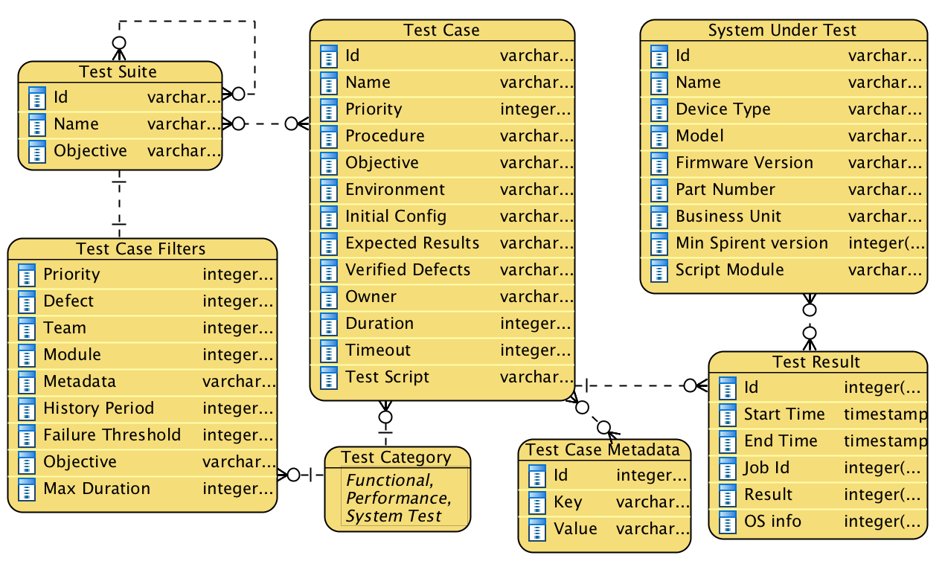
Component Description – Test Case Library ER Model

Slide 24
Component Description – Test Case Library ER Model
Test Case - core entity that represents a single test case
Priority - priority of the test case
Initial test configuration, environment, procedure, expected results - attributes that are descriptive of running the test
Duration, Timeout – timing attributes
Verified Defects – Specific defects targeted by test case
Owner – team or user that owns test case
Test Category - indicates Acceptance vs Unit vs Performance test, etc.
System Under Test - identifies DUT. A test case can be applicable to many DUTs.
Test Case Metadata – Extensible set of key value pairs to decorate Test Cases. Examples:
Key Value
MarketSegment CDC
MarketSegment AVALANCHE
Protocol BGP_BLL
Protocol MULTICAST_IL

Slide 25
Component Description – Test Case Library ER Model
Test Suite – container of Test Cases.
Membership can be rule based as well as list based.
Rule based containment will be defined on Test Case Metadata or Test Case attributes such as Test Category. It will be dynamically evaluated to generate the relevant test cases or test sets.
A simple rule like “Test Category = Functional” will automatically include test cases which are marked Functional, even ones added subsequently. In contrast, list based containment will explicitly enumerate Test Cases
Test suites can be nested.
Test cases can be grouped into multiple hierarchies - by feature test coverage, by customer or market segment, by release, etc.
Test Result - will record execution history. This can be used to query tests which have been failing recently.

Slide 26
Component Description – Test Case Library ER Model
Test Case Filters – filter expression for test cases:
Priority – test case priority
Test Category– Functional vs Unit vs Performance test cases, etc.
Defects – test cases that verify specific defect(s)
Team – test cases owned by specific team
Module – test cases targeting specific hardware / firmware
Metadata – select test cases based on metadata, for example test cases tagged as “BGP*”
History Period, Failure Threshold – these 2 filter attributes are intended to be used together, to select test cases which have a certain failure rate over the specified past period.
Objective – test cases whose Objective contains given keyword(s).
Duration – test cases whose Duration property don’t exceed given limit.
These filter criteria can be combined.

Slide 27
Appendix – Design Notes
Test case metadata
Storing test case information in separate json files accompanying test scripts, instead of embedding as docstring in the Python script itself, has the following advantages:
the metadata is fairly sizable, since we are dealing with quite a bit of information. It is more readable to keep this in a separate file, rather than as a big blob at the beginning of every test script.
From a revision POV, metadata may change infrequently compared to the Python code. Keeping it in a separate file reduces the likelihood of unintended json formatting breakage.
Conversely if we ever discover the need to upgrade / update the json schema, it will be cleaner with no risk of breaking the Python script. Customers may be adverse to editing their scripts to add metadata
We will still satisfy the objective of keeping code and metadata close and a single source of truth. The onus of keeping the metadata file in sync with the script is about the same as keeping docstrings updated.

Slide 28
References
pyATS
https://pubhub.devnetcloud.com/media/pyats/docs/topology/index.html
https://developer.cisco.com/netdevops/live/#s01t08

